Slide 1

CSE205
Data Structures And Algorithms
Lecture #3
Arrays
By: Mohammad Shabaz

Slide 2
Introduction
What is Array?
Array is a datatype which is widely implemented as a default type, in almost all the modern programming languages, and is used to store data of similar type.
Array supports Random Access, which means elements can be accessed directly using their index, like arr[0] for 1st element, arr[6] for 7th element etc. Hence, accessing elements in an array is fast with a constant time complexity of O(1).
In an array, elements are stored in contiguous memory location or consecutive manner in the memory.

Slide 3
Important Points about Array
In array, Insertion and Deletion operation takes more time, as the memory locations are consecutive and fixed.
Memory is allocated as soon as the array is declared, at compile time. It's also known as Static Memory Allocation.
In array, each element is independent and can be accessed using it's index value.
Array can be single, two or multidimensional.
Size of the array must be specified at time of array declaration.
Array gets memory allocated in the Stack section.

Slide 4
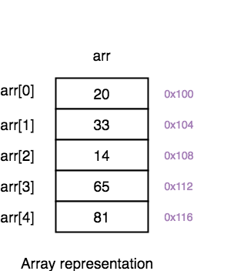
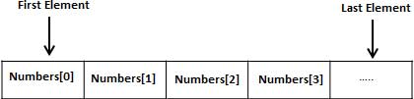
Array Representation

Slide 5
Array Declaration
Array declaration in various programming languages:
Array in C/C++:
type arrayName [ arraySize ];
Array in C#:
datatype[] arrayName;
Array in Java:
type var-name[]; OR type[] var-name;
Array in Python:
arrayName = array(typecode, [Initializers])

Slide 6
Operations on Array
Traversing
Searching
Inserting
Deleting
Sorting
Merging

Slide 7
Traversing
1. Traversing: It is used to access each data item exactly once so that it can be processed.
E.g.
We have linear array A as below:
1 | 2 | 3 | 4 | 5
10 | 20 | 30 | 40 | 50
Here we will start from beginning and will go till last element and during this process we will access value of each element exactly once as below:
A [1] = 10
A [2] = 20
A [3] = 30
A [4] = 40
A [5] = 50

Slide 8
Searching
2. Searching: It is used to find out the location of the data item if it exists in the given collection of data items.
E.g.
We have linear array A as below:
1 | 2 | 3 | 4 | 5
15 | 50 | 35 | 20 | 25
Suppose item to be searched is 20. We will start from beginning and will compare 20 with each element.
This process will continue until element is found or array is finished. Here:
1) Compare 20 with 15
20 # 15, go to next element.
2) Compare 20 with 50
20 # 50, go to next element.
3) Compare 20 with 35
20 #35, go to next element.
4) Compare 20 with 20
20 = 20, so 20 is found and its location is 4.

Slide 9
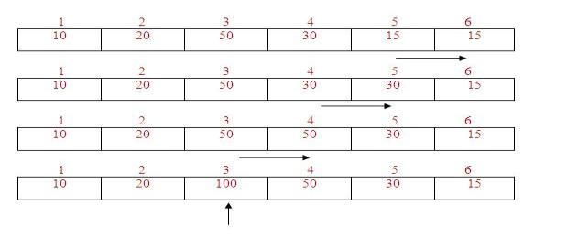
Insertion
New element to be inserted is 100 and location for insertion is 3. So shift the elements from 5th location to 3rd location downwards by 1 place. And then insert 100 at 3rd location. It is shown below:
3. Insertion: It is used to add a new data item in the given collection of data items.
E.g.
We have linear array A as below:
1 | 2 | 3 | 4 | 5
10 | 20 | 50 | 30 | 15
New element to be inserted is 100 and location for insertion is 3. So shift the elements from 5th location to 3rd location downwards by 1 place. And then insert 100 at 3rd location. It is shown below:

Slide 10
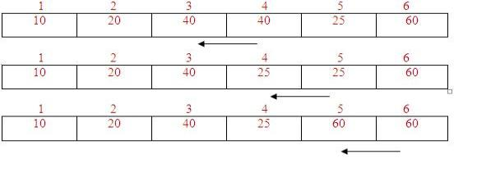
Deletion
4. Deletion: It is used to delete an existing data item from the given collection of data items.
E.g.
We have linear array A as below:
1 | 2 | 3 | 4 | 5
10 | 20 | 50 | 40 | 25 | 60
The element to be deleted is 50 which is at 3rd location. So shift the elements from 4th to 6th location upwards by 1 place. It is shown below:
After deletion the array will be:
1 | 2 | 3 | 4 | 5 | 6
10 | 20 | 40 | 25 | 60

Slide 11
Sorting
5. Sorting: It is used to arrange the data items in some order i.e. in ascending or descending order in case of numerical data and in dictionary order in case of alphanumeric data.
E.g.
We have linear array A as below:
1 | 2 | 3 | 4 | 5
10 | 50 | 40 | 20 | 30
After arranging the elements in increasing order by using a sorting technique, the array will be:
1 | 2 | 3 | 4 | 5
10 | 20 | 30 | 40 | 50

Slide 12
Merging
6. Merging: It is used to combine the data items of two sorted files into single file in the sorted form
We have sorted linear array A as below:
1 | 2 | 3 | 4 | 5 | 6
10 | 40 | 50 | 80 | 95 | 100
And sorted linear array B as below:
1 | 2 | 3 | 4
20 | 35 | 45 | 90
After merging sorted array, we have:
1 | 2 | 3 | 4 | 5 | 6 | 7 | 8 | 9 | 10
10 | 20 | 35 | 40 | 45 | 50 | 80 | 90 | 95 | 100

Slide 13
Some Quick MCQs

Slide 14
a) Sequential b) Random c) Sequential and Random d) None of the above
An array elements are always stored in ________ memory locations.

Slide 15
a) char name[6] = {'I','N','D','I','A'}; b) char name[6] = {'I','N','D','I','A','\0'} c) char name[6] = {"I","N","D","I","A"} d) name = "INDIA"
In C Programming, If we need to store word “INDIA” then syntax is as below –
char name[];
name = “INDIA”

Slide 16
a) Garbage Value b) 5 c) 6 d) 0
What will be printed after execution of the following code?
void main() {
int arr[10] = {1,2,3,4,5};
printf("%d", arr[5]);
}

Slide 17
a) 0 0 b) Garbage value 0 c) 0 Garbage Value d) Garbage value Garbage Value e) Code will not compile
What will be the output of the following code?
#include “stdio.h”
void main() {
int a[10];
printf("%d %d", a[-1], a[12]); }

Slide 18
a) 1 b) 0 c) 10 d) 6
What will be the output of the program ?
#include "stdio.h"
int main() {
int arr[5] = {10};
printf("%d", 0[arr]);
return 0; }

Slide 19
a) 5 b) 4 c) 6 d) 7
What will be the output of the program ?
#include “stdio.h”
void main()
{
float arr[] = {12.4, 2.3, 4.5, 6.7};
printf(“%d”, sizeof(arr)/sizeof(arr[0]));
}

